Slide 1
AMAZON ORDERS DATA ANALYSIS PROJECT
Using Python, Excel, SQL, and Power BI
Presented By:-
Sherin Kousar.

Slide 2
PROJECT OVERVIEW

Slide 3
Objective
To analyze Amazon orders data and identify business insights related to:
Sales trends
Customer behavior
Revenue generation
Shipping performance
cancellations

Slide 4
Dataset
Approx. 128K records
E-commerce transactional dataset

Slide 5
Tools Used
Tools | Purpose
Python | Data Cleaning
Excel | Pivot Tables
SQL | Query Analysis
Power BI | Dashboard & Visualization

Slide 6
WORKFLOW / PROCESS

Slide 7
PROJECT WORKFLOW
Raw Dataset
Python Data Cleaning
Excel Analysis
SQL Queries
Power BI Dashboard
Insights & Recommendations

Slide 8
POWER bi DASHBOARD OVERVIEW

Slide 9
Dashboard Pages
Overview KPIs
Orders Insights
Revenue Analysis
General Insights
Detailed Orders Explorer

Slide 10
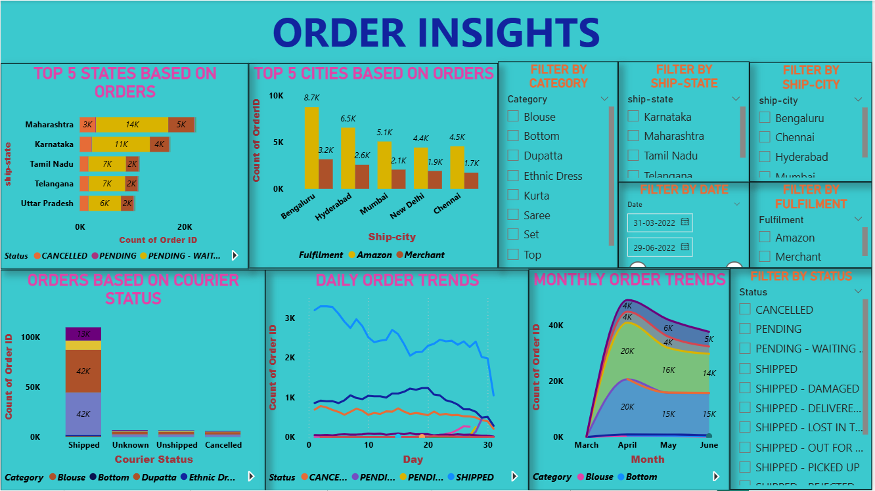
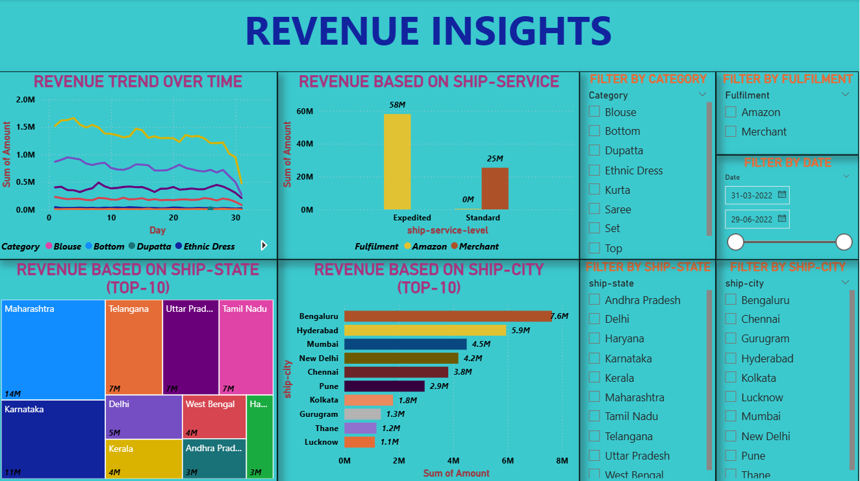
Revenue Insights Dashboard
Order Insights Dashboard

Slide 11
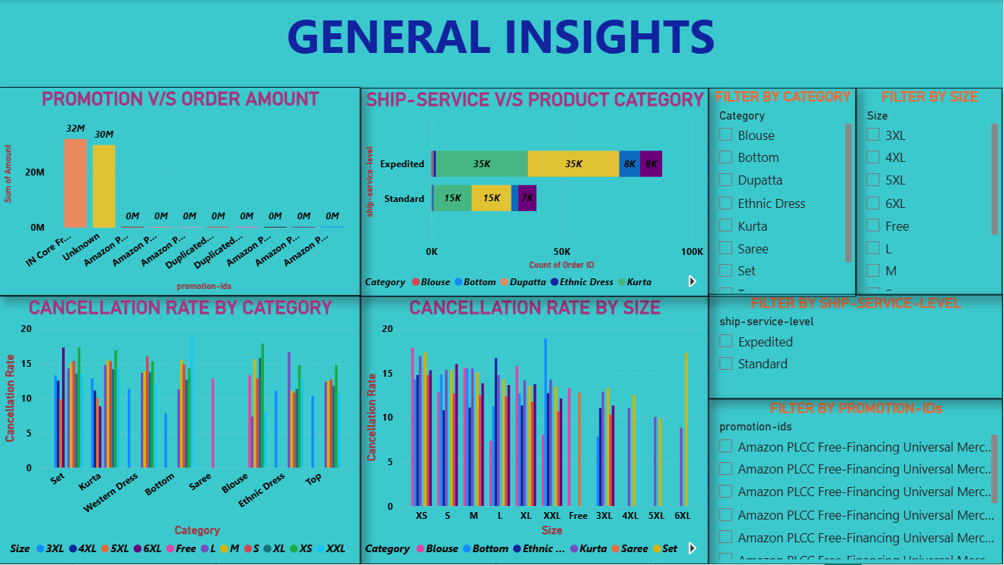
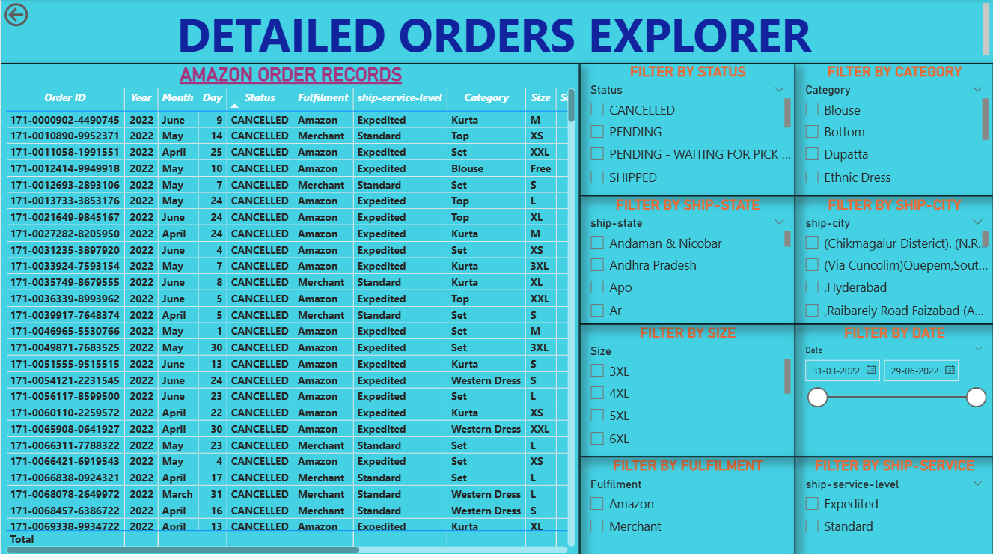
Detailed Orders Explorer Dashboard
General Insights Dashboard

Slide 12
KEY KPI METRICS

Slide 13
KPI | VALUE
Total Orders | 128,975
Total Revenue | 83.64M
Average Order Amount | 643.51
Cancellation Rate | 14.21%

Slide 14
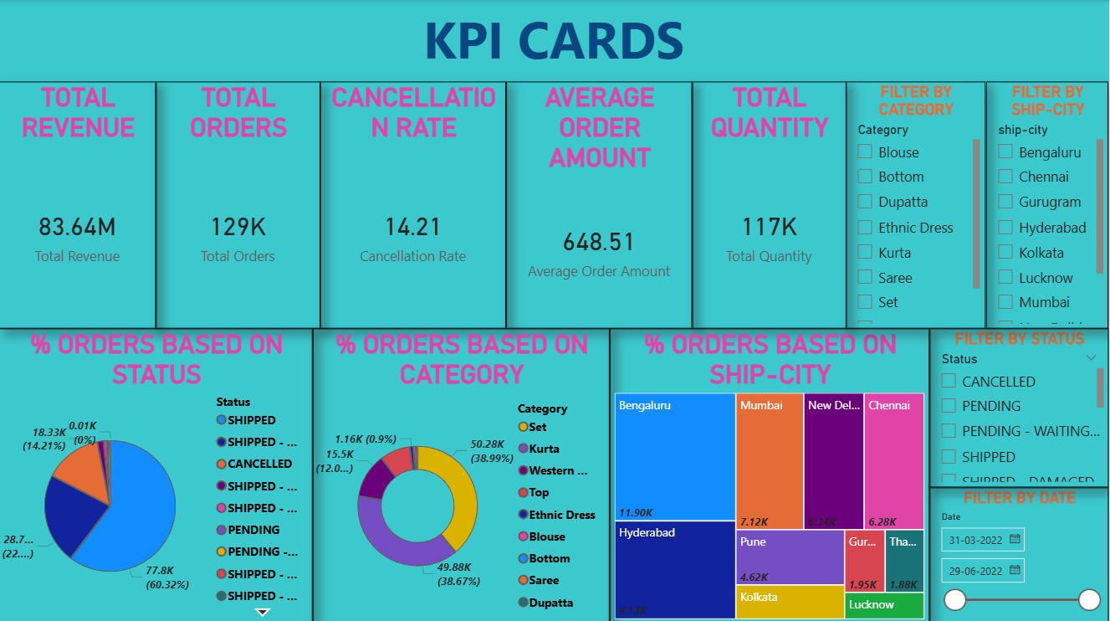
Overview kpi’s

Slide 15
KEY BUSINESS INSIGHTS

Slide 16
Key Insights
Set category generated highest revenue.
Metro cities contributed maximum sales.
Promotions positively influenced order amounts.
Medium and Large sizes were most preferred.
Certain categories showed higher cancellation rates.

Slide 17
BUSINESS STRATEGIES & RECOMMENDATIONS

Slide 18
Strategies
Focus inventory on high-performing categories.
Improve shipping and delivery performance.
Reduce cancellations through better size accuracy.
Use targeted promotions and discounts.
Focus marketing on high-revenue cities.

Slide 19
Recommendations
Improve customer experience
Optimize logistics
Monitor cancellation trends
Enhance product descriptions

Slide 20
CONCLUSION

Slide 21
CONCLUSION
This project successfully analyzed Amazon orders data using Python, Excel, SQL, and Power BI. The project identified important business trends related to sales, customer behavior, shipping services, promotions, and cancellations.
The interactive dashboard and analytical insights can help businesses make better data-driven decisions and improve profitability.

Slide 22
THANK YOU

